Slide 1
UNIT-2

Slide 2
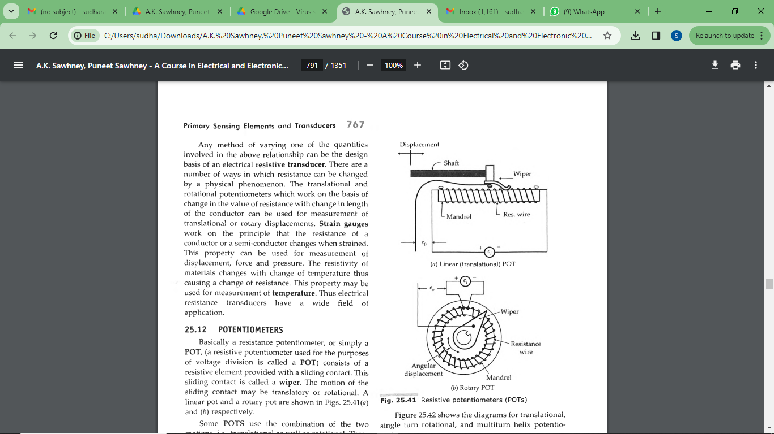
potentiometer
Basically a resistance potentiometer, or simply a POT, (a resistive potentiometer used for the purposes of voltage division is called a POT)
consists of a resistive element provided with a sliding contact. This sliding contact is called a wiper. The motion of the sliding contact may be translatory or rotational.
Some POTS use the combination of the two motions, i.e., translational as well as rotational. These POTS have their resistive element in the form of a helix and therefore, they are called helipots.

Slide 3
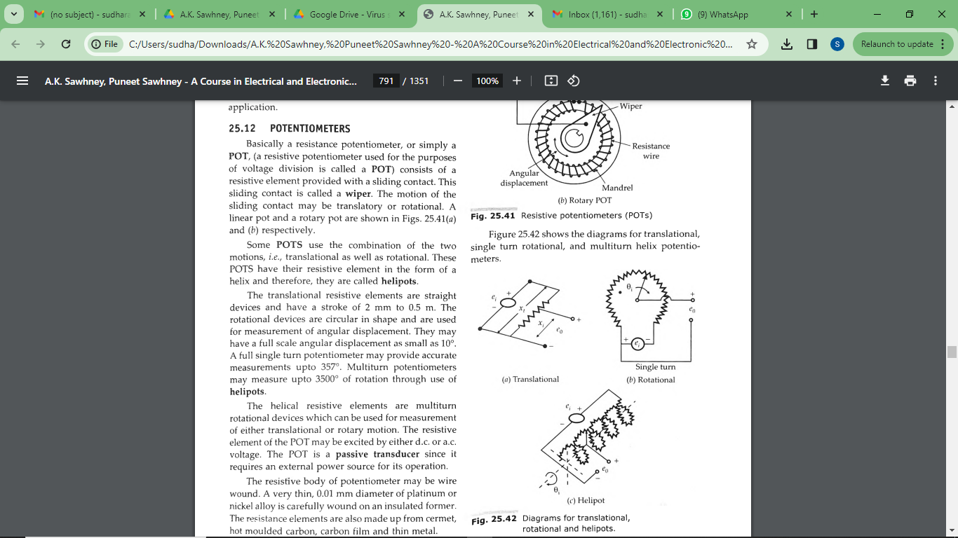
Diagrams for translational, rotational and helipots.

Slide 4
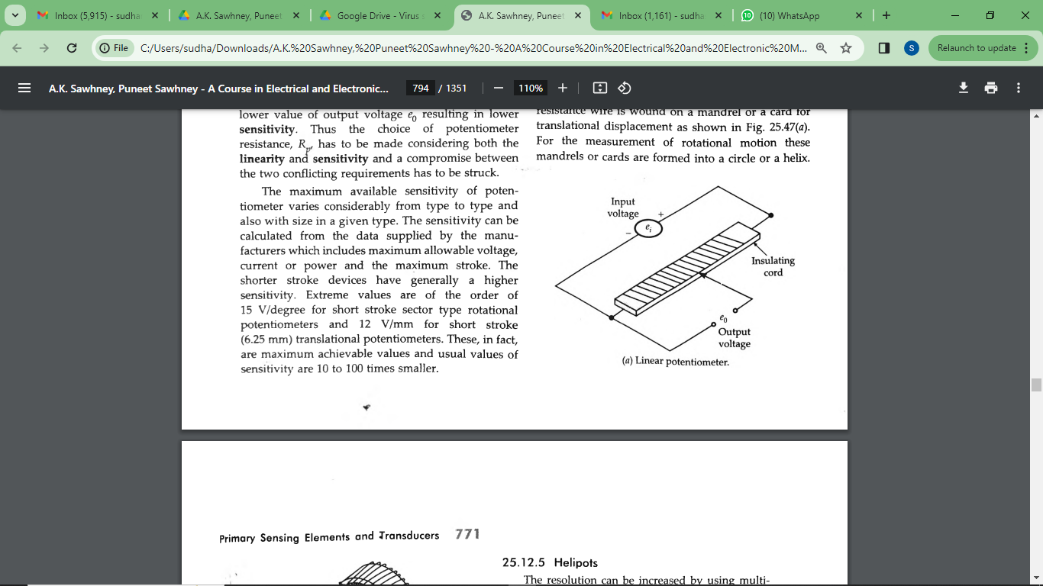
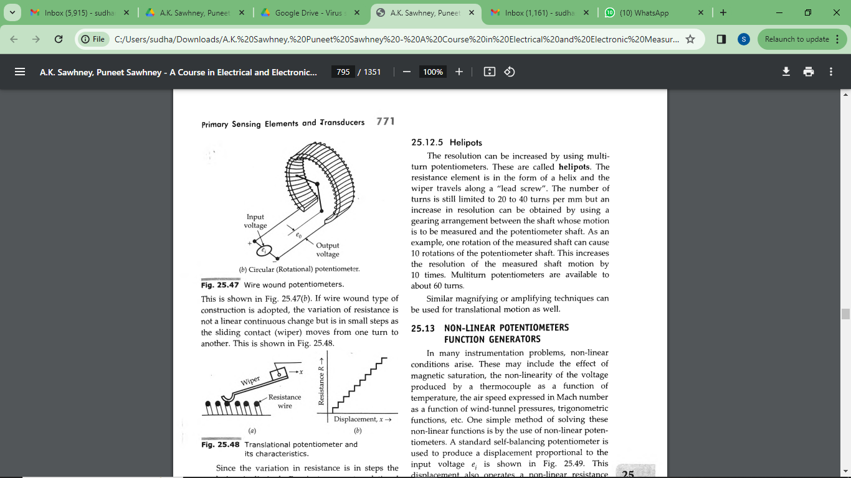
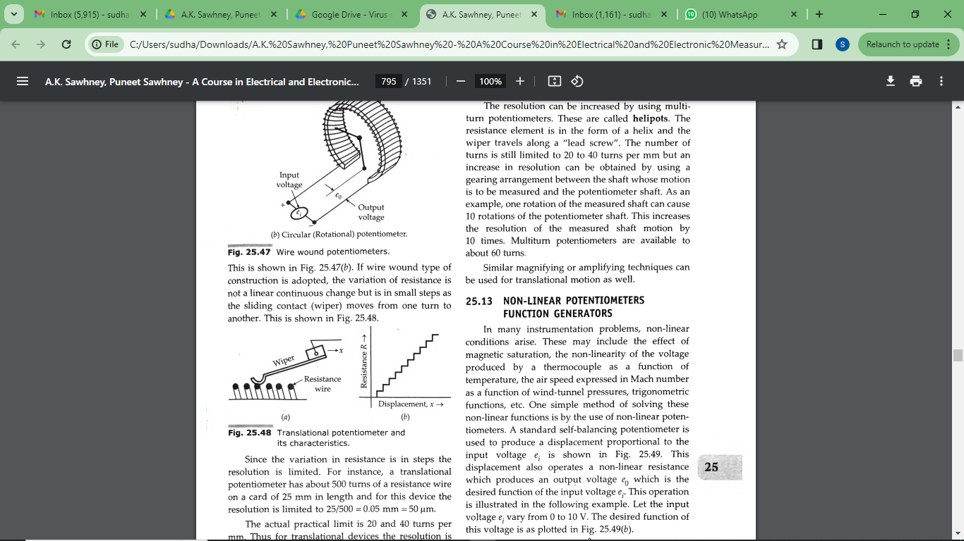
Construction of Potentiometers
Normally, the resistive element is a single wire of conducing material which gives a continuous stepless variation of resistance as the wiper travels over it.
Such potentiometers are available but their length (in the case of translational potentiometers) and diameter (in the case of rotational potentiometers) restrict their use on account of space considerations.
The resolution of the potentiometers is dependent upon the construction of the resistive element and in order to get high values of resistance in small space wire wound potentiometers ar.
The resistance wire is wound on a mandrel or a card for translational displacement e used extensively
For the measurement of rotational motion these mandrels or cards are formed into a circle or a helix.
If wire wound type of construction is adopted, the variation of resistance is not a linear continuous change but is in small steps as the sliding contact (wiper) moves from one turn to another

Slide 5
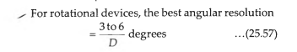
For instance, a translational potentiometer has about 500 turns of a resistance wire on a card of 25 mm in length and for this device the resolution is limited to 25/500 = 0.05 mm = 50 micro meters.

Slide 6
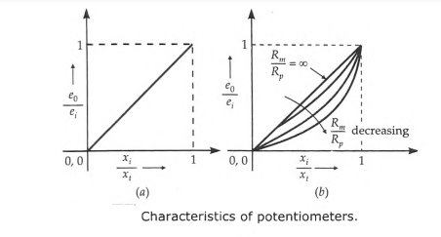
Above Equations are based upon the assumption that the distribution of resistance with respect to linear or angular displacement is uniform and the resistance of the voltage measuring device (i.e. output device) is infinite.

Slide 7
Strain Gauges

Slide 8
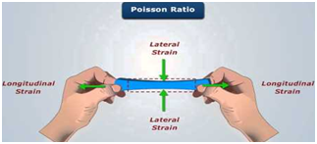
if a metal conductor is stretched or compressed, its resistance changes on account of Le fact that both length and diameter of conductor change.
Also there is a change in the value of resistivity of the conductor when it is strained and this property is called piezo resistive effect.
Also there is a change in the value of resistivity of the conductor when it is strained and this property is called piezo resistive effect.
Therefore, resistance strain gauges are als0 known as piezoresistive gauges.
If a strip of elastic material is subjected to tension (positively strained) its longitudinal dimension will increase while there will be a reduction in the lateral dimension.

Slide 9

Theory of Strain Gauges.
If a strip of elastic material is subjected to t~nsion, or in other words positively strained, its lcugitudinal dimension will increase while there will be a reduction in the lateral dimension.
So when a gauge is subjected to a positive strain, its length increases while its area of cross-section decreases.
Since the resistance of a conductor is proportional to its length and inversely proportional to its area of cross section,
the resistance of the gauge increases with positive strain.
Let us consider a strain gauge made of circular wire ...
The ·wire has the dimensions ; length=L, area= A, diameter=D before being strained.
The material of the wire has a resistivity p.
:. Resistance of unstrained gauge R=pL/A.

Slide 10
Types of Strain Gauges
There are three types of strain gauges :
(i) Wire wound strain gauges,
(ii) Foil type strain gauges, and
(iii) Semiconductor strain gauges.

Slide 11
The following are the major types of strain gauges
Unbonded metal strain gauges
Bonded metal wire strain gauges
Bonded metal foil strain gauges
Vacuum deposited thin metal film strain gauges
Sputter deposited thin metal strain gauges
Bonded semiconductor strain gauges
Diffused metal strain gauges

Slide 12
Strain gauges are broadlyused for two majority types of applications and they are :
Experimental stress analysis of machines and structures, and
Construction of force, torque, pressure, and acceleration transducers

Slide 13

UNBONDED Unbonded metal strain gauges
This gauge consists of a wire stretched between
two points in an insulating medium such as air.
The wires may be made of various copper nickel, chrome nickel or nickel iron alloys.
They are about 0.003 mm in diameter, have a gauge factor of 2 to 4 and sustain a force of 2 mN. The length of wire is 25 mm or less.
the flexture element is connected via a rod to a diaphragm which is used for sensing of pressure.
employ preloaded resistance wires connected in a Wheatstone bridge.

Slide 14
At initial preload , the strains and resistances of the four arms are nominally equal. with the result the output voltage of the bridge e₀ =0.
Application of pressure produces a small displacement which is about 0.004 mm (full scale),
the displacement increases tension in two wires and decreases it in the other two,
thereby increase the resistance of two wires which are in tension and decreasing the resistance of the remaining two wires.
This causes an unbalance of the bridge producing an output voltage which is proportional to the input displacement and hence to the applied pressure.
Electric resistance of each arm is 120 ohms to 1000 ohms. the input voltage to the bridge is 5 to 10 V, and the full scale output of the bridge is typically about 20 mV to 50 mV.

Slide 15
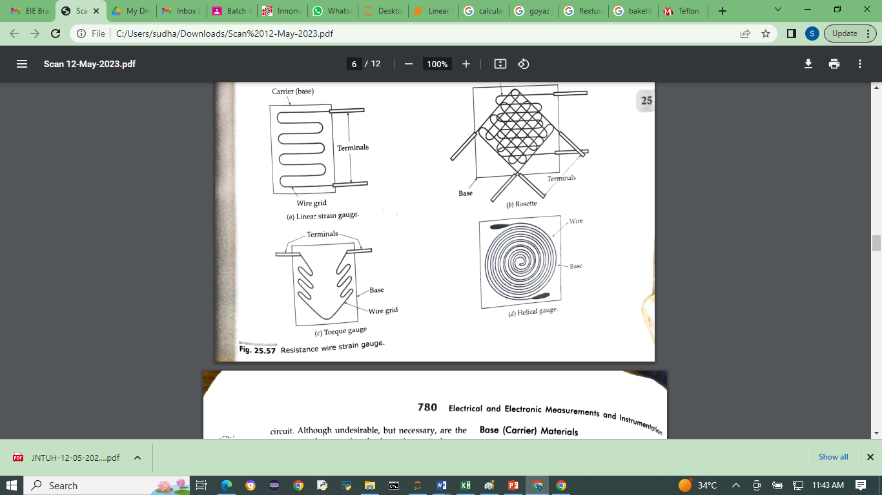

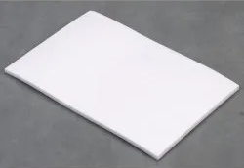
Bonded Wire Strain Gauges
The bonded metal-wire strain gauges are used for
both stress analysis and for construction of transducers.
A resistance wire strain gauge consists of a grid of fine resistance wire of about 0.025 mm in diameter or less.
The grid is cemented to carrier (base) which may be a thin sheet of paper, a thin sheet of Bakelite or a sheet of Teflon.
The wire is covered on top with a thin sheet of material so as to prevent it from any mechanical damage.
The spreading of wire permits a uniform distribution of stress over the grid.
Bakelite sheet
Teflon

Slide 16
The carrier is bonded with an adhesive material to the specimen under study.
This permits a good transfer of strain from carrier to grid of wires.
The wires may be made of various copper nickel, chrome nickel or nickel iron alloys.
The size of the strain gauges varies with application. They can be as small as 3 mm by 3 cm square. Usually they are larger but seldom more than 25 mm long and 12.5 mm wide.

Slide 17
Resistance wire strain gauges should have the following characteristics:
(i) The strain gauge should have a high value of gauge factor G_{f} , indicates a large change in resistance for a particular strain resulting in high sensitivity.
(ii) The resistance of the strain gauge should be as high as possible since this minimizes the effects of undesirable variations of resistance in the measurement.
(iii) The strain gauges should have a low resistance temperature co-efficient. This is essential to minimise errors on account of temperature variations which affect the accuracy of measurements.
(iv) The strain gauge should not have any hysteresis effects in its response.
(v) the variations in resistance should be a linear function of the strain.
vi) The strain gauges are frequently used for dynamic measurements and hence their frequency response should be good. The linearity should be maintained within accuracy limits over the entire frequency range.

Slide 18
Base (Carrier) Several types of base or carrier materials are used to support the wires.
Impregnated paper is Used for room temperature applications. The range of some the other materials is :
Epoxy:
-200°C to 150°C,
Bakelite cellulose or fibre glass materials:
-upto 200°C for continuous operation and 300°C for limited operation
Adhesives
Ethylcellucose cement, nitrocellucose cement. bakelite cement and epoxy cement are some of the commonly used adhesive materials.
The temperature range up to which they can be used is usually below 175°C.
Leads
The leads should be of such materials which have low and stable resistivity and also a low resistance temperature co-efficient.

Slide 19

Mo-Molybdenum

Slide 20

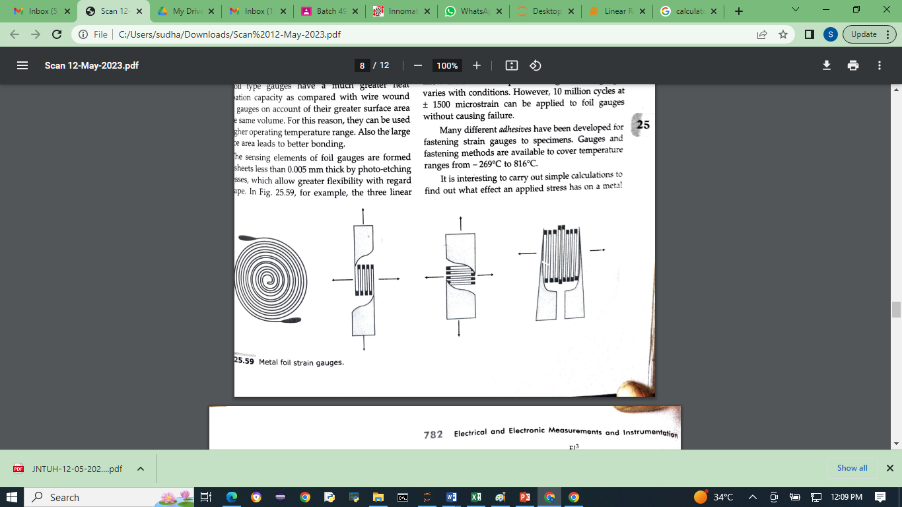
Bonded metal foil strain gauges
In foil gauges, the required grid pattern is formed with a very thin foil which is the same material used for wire gauges.
Due to the larger surface area to area of cross-section ratio, it has a higher heat dissipation capability and hence better thermal stability.
The strain reproducibility is excellent
When a force or pressure is applied to the device, its physical dimensions will change.
Since a metal foil strain gauge is pasted on its surface, the dimensions of the metal foil strain gauge change, which causes it to change its resistance.

Slide 21
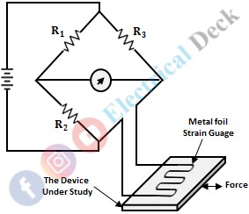
When a force or pressure is applied to the device, its physical dimensions will change.
Since a metal foil strain gauge is pasted on its surface, the dimensions of the metal foil strain gauge change, which causes it to change its resistance.
This change in resistance can be measured by connecting this gauge in one of the 4 arms of the balanced Wheatstone bridge.
This connection makes the bridge unbalance, and some output voltage will be generated which gives the value of resistance.
This measured resistance gives the applied force.

Slide 22
Specifications of Bonded Strain Gauge :
Typical size - Typically 3mm × 3mm × 3mm, but some times bigger than 2.5mm × 12.5mm
Resistance - 120Ω to 1000Ω
Maximum excitation voltage - 5 V to 10 V
Construction material - Nichrome-copper, nickel-chromium, or nickel-ferrous alloys.
Advantages of Bonded Strain Gauge :
Accuracy is more.
This can be available in different shapes.
High sensitivity and stability.
Perfect bonding can be done.
Can measure high pressure.
Disadvantages of Bonded Strain Gauge :
These are sensitive to change in temperature.

Slide 23
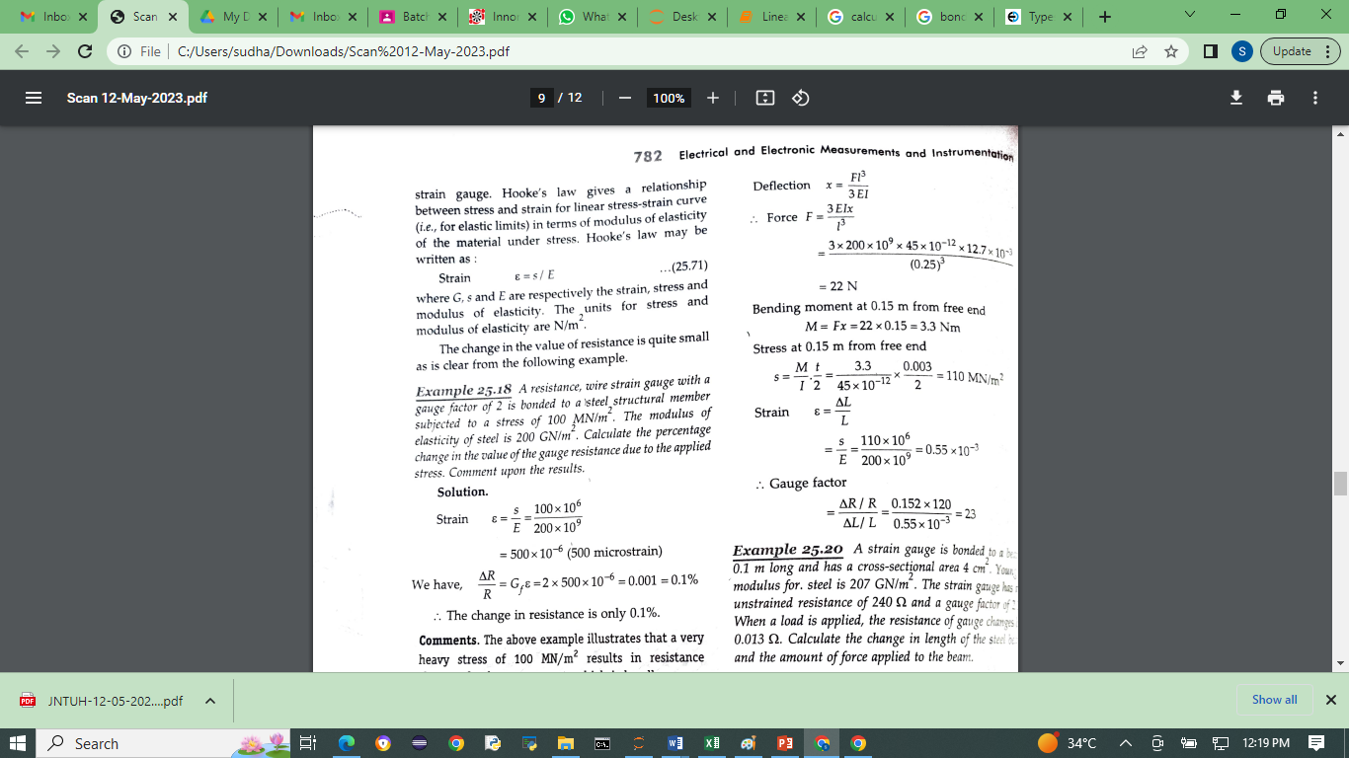

Hooke's law gives a relationship between stress and strain for linear stress-strain curve (i.e., for elastic limits) in terns of modulus of elasticity of the material under stress.
Hooke's law may be written as :

Slide 24
Vacuum deposited/Evaporation deposited thin metal film strain gauges
Evaporation deposited thin film metal strain gauges are mostly used for the fabrication of Transducers.
They are sputter deposited variety.
Both processes begin with a suitable elastic metal element.
The elastic metal element converts the physical quantity into a strain.
In the evaporation process, the diaphragm is placed in a vacuum chamber with some insulating material.
Heat insulating is applied until the insulating material vaporises and then condenses, then forming a thin dielectric material on the diaphragm.

Slide 25
https://www.youtube.com/watch?v=-lm0Y3Hyw-Q
Suitably shaped templates are placed over the diaphragm, and the evaporation and condensation processes are repeated with the metallic gauge material, forming the desired strain gauge pattern on top of the insulating substrate.

Slide 26
In the sputtering process, a thin dielectric layer is deposited in vacuum over the entire surface.
The complete layer of metallic gauge is sputtered on the top of the dielectric material without using any substrate.
The diaphragms are now removed from the vacuum chamber, and micro imaging techniques using photo masking materials are used to form the gauge pattern.
The diaphragms are then returned to the vacuum chamber. Sputter etching techniques are used to remove all unmasked metal layer, leaving behind the desired gauge pattern.

Slide 27
semiconductor strain gauges
For high sensitivity, a high value of gauge factor is desirable.
A high gauge factor means a relatively higher change in resistance which can be easily measured with a good degree of accuracy.
Semiconductor strain gauges are used where a very high gauge factor and a small envelope are required.
The resistance of the semi-conductors changes with change in applied strain.
Unlike in the case of metallic gauges where the change in resistance is mainly due to change in dimensions when strained, the semi-conductor strain gauge depend for their action upon piezo-resistive effect i.e., the change in the value of the resistance due to change in resistivity

Slide 28

A typical semiconductor strain gauge is formed by the semiconductor technology i.e., the
semiconducting wafers or filaments of length varying from 2 mm to 10 mm and thickness of
0.05 mm are bonded on suitable insulating substrates (for example Teflon).
The gold leads are usually employed for making electrical contacts. The electrodes are formed by vapour
deposition.

Slide 29
The strain sensitive, elements used by the semiconductor strain gauge are the semiconductor materials such as, silicon and germanium.
When the strain is applied to the semiconductor element a large of change in resistance occur which can be measured with the help of a wheatstone bridge.
The strain can be measured with high degree of accuracy due to relatively high change in resistance.
A temperature compensated semiconductor strain gauge can be used to measure small strains of the order of 10⁻⁶ i.e., micro-strain.
This type of gauge will have a gauge factor of 130 ± 10% for a semiconductor material of dimension 1 x 0.5 x 0.005 inch having the resistance of 350 Ω.

Slide 30
Diffused Strain Gauges
In pressure transducers, for example, the diaphragm would be of silicon rather than metal and the strain gauge effect would be realized by depositing impurities in the diaphragm to form an intrinsic strain gauge.
This type of construction may allow lower manufacturing costs in some designs, as a large number of diaphragms can be made on a single silicon wafer.

Slide 31
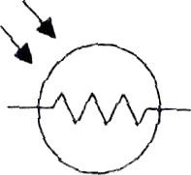
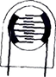
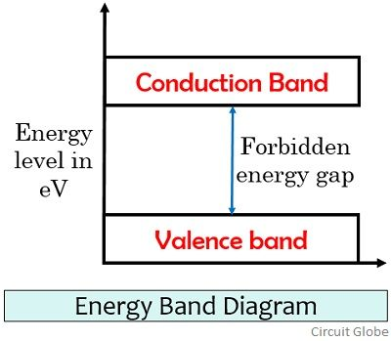
Light-dependent resistors (LDRs)
photo resistors, photoconductors—rely on the variation in electric resistance in a semiconductor caused by the incidence of optical radiation (electromagnetic radiation with wavelength from I mm to 10 nm—300 GHz to 30 PHz).
Light-dependent photo resistor.

Slide 32

LDR encapsulated in transparent Plastic
The electrical conductivity of a material depends on the number of charge carriers in the conduction band.
Most of the electrons in a semiconductor at ambient temperature are in the valence band.
Thus it behaves like an electrical insulator.
But when its temperature rises, electron vibrations increase; and because valence and conduction bands are very close in semiconductors ,
there is an increasing number of electrons raised from the valence band to the conduction band, thus increasing the conductivity.
In a doped semiconductor, this raising of electrons is even easier because, in addition to band-to-band transitions,
A donor atom can be ionized, thus contributing an electron to the conduction band,
Or an acceptor atom can be ionized, thus leaving behind a hole in the valence band.
The sensitivity to incident radiation depends on how long these carriers remain free before recombining

Slide 33
The energy needed to raise electrons from the valence to the conduction
band can be provided by extremal energy sources other than heat.
For example by optical radiation or by an electric voltage. The energy E and frequency f, then optical radiation E=hx f , h= 6.62×10⁻³⁴ J.s

Slide 34

RESISTANCE THERMOMETERS
Sit Dolor Amet

Slide 35
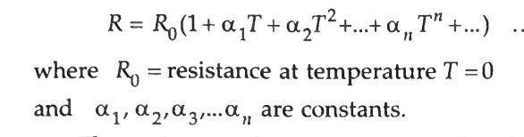
RESISTANCE THERMOMETERS
The resistance of a conductor changes when its temperature is changed. This property is utilized for measurement of temperature.
The resistance thermometer uses the change in electrical resistance of conductor to determine the temperature.
Platinum is especially suited for this purpose, as it can withstand high temperatures while maintaining excellent stability
Gold and Silver are rarely used for construction of RTDs on account of their low resistivities. Tungsten has relatively a high resistivity, but is reserved for high temperature applications as it is extremely brittle and difficult to work.
Copper is used occasionally as an RTD element. Its low resistivity forces the element to be longer than the platinum element, but its low linearity and low cost make it an economical alternative. Its upper limit of temperature is about 120°C.

Slide 36
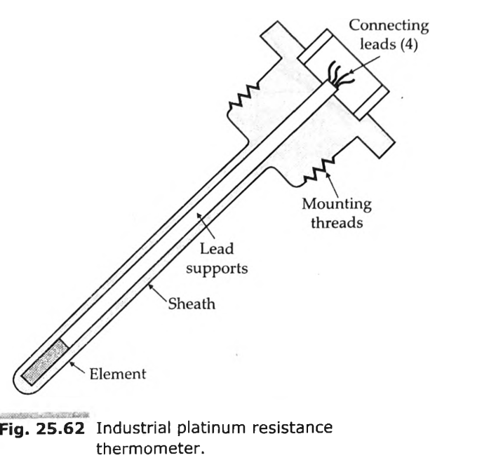
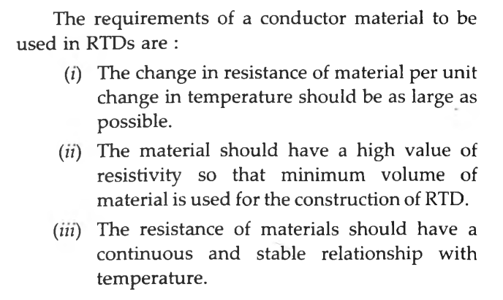
The most common RTDs are made of either platinum, nickel or nickel alloys. The economical nickel wires are used over a limited temperature range. They are quite non-linear and tend to drift with time.
For measurement integrity, platinum is the obvious choice.
The single most common value is 100 Q at 0°C with a resistance temperature co-efficient of 0.00385/°C.
The more chemically pure platinum wire has a resistance temperature co-efficient of 0.00392/°C.

Slide 37
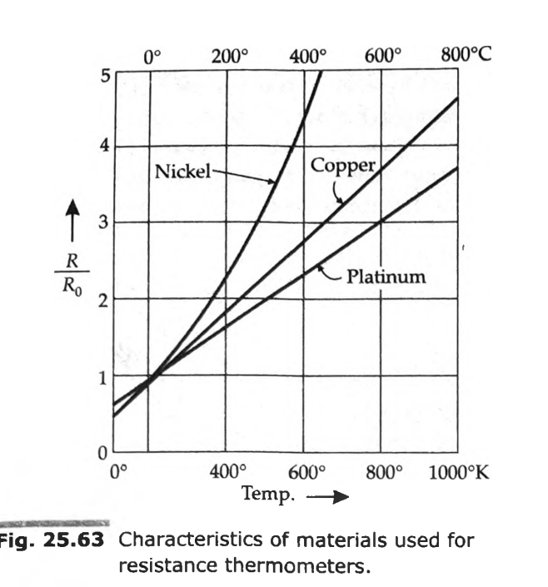
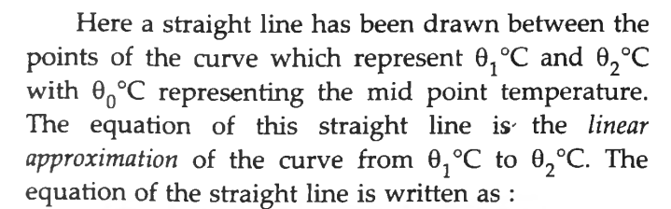
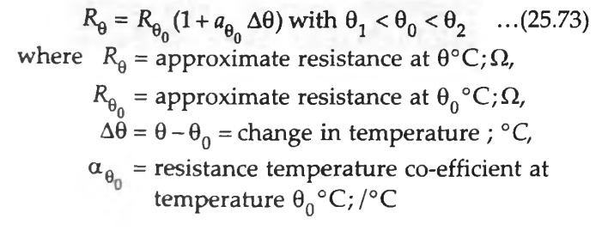
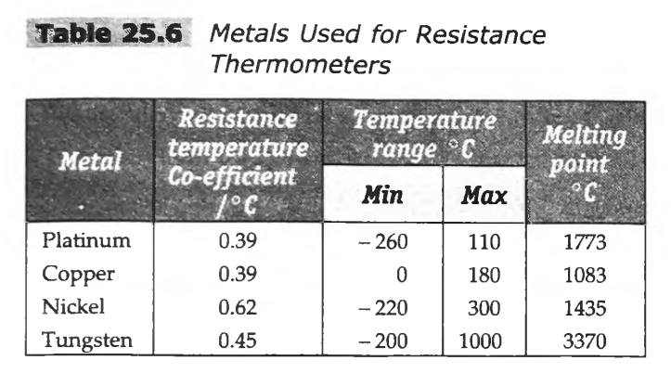
Linear Approximation
A linear approximation means that we may develop an equation for a straight line which approximates the resistance versus temperature curve over a specified span.

Slide 38
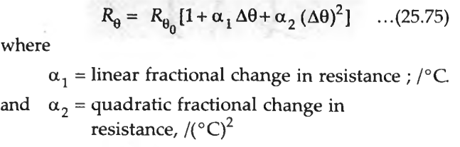
Quadratic Approximation
A quadratic approximation of the resistance temperature curve is more accurate representation of the curve over a limited range of temperature.
which varies as the square of the difference in temperature.

Slide 39
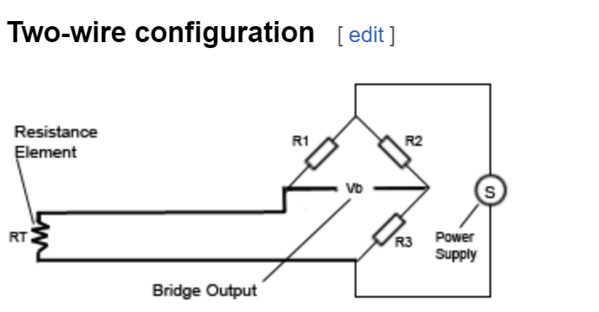
Two wire configuration OF RTD
The simplest resistance-thermometer configuration uses two wires.
It is only used when high accuracy is not required, as the resistance of the connecting wires is added to that of the sensor, leading to errors of measurement.
This configuration allows use of 100 meters of cable. This applies equally to balanced bridge and fixed bridge system.

Slide 40
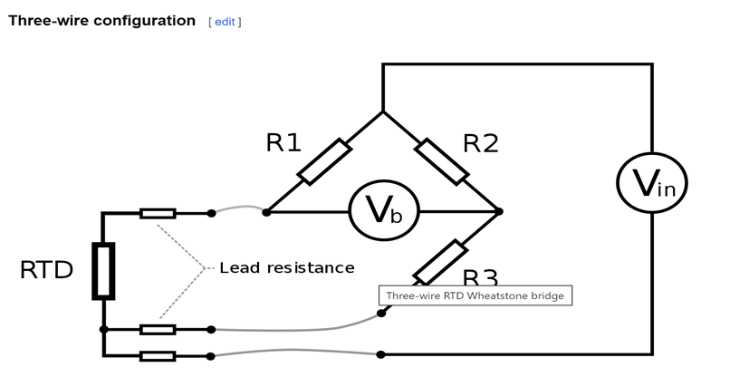
Three wire configuration OF RTD
In order to minimize the effects of the lead resistances, a three-wire configuration can be used.
R1 = R2, and R3 around the middle of the range of the RTD.
the voltage drop on the lower left hand side is V_rtd + V_lead,
and on the lower right hand side is V_R3 + V_lead,
bridge voltage (V_b) is the difference, V_rtd − V_R3.
(V_b)= V_rtd − V_R3
The voltage drop due to the lead resistance has been cancelled out.
This always applies if R1=R2, and R1, R2 >> RTD, R3. R1 and R2 can serve the use of limiting the current through the RTD,

Slide 41
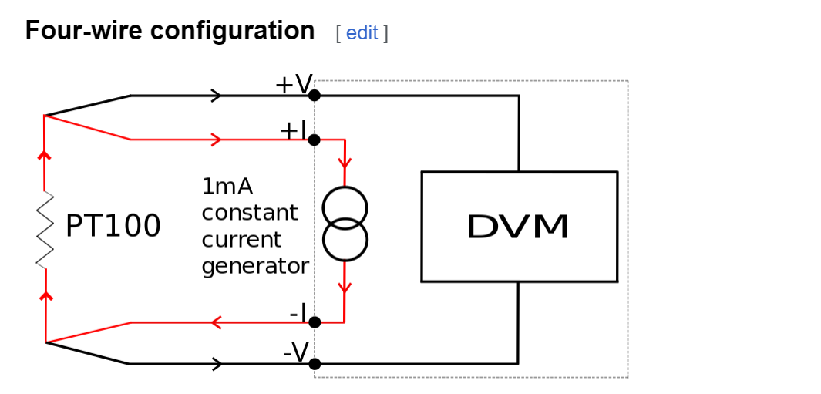
Four wire configuration OF RTD
The four-wire resistance configuration increases the accuracy of measurement of resistance.
Four-terminal sensing eliminates voltage drop in the measuring leads as a contribution to error.

Slide 42
THERMISTORS
Thermistor is a contraction of a term "thermal resistors".
Thermistors are generally composed of semi-conductor materials.
most thermistors have a negative coefficient of temperature resistance i.e. their resistance decreases with increase of temperature.
The negative temperature coefficient of resistance can be as large as several percent per degree Celsius.
This allows the thermistor circuits to detect very small changes in temperature which could not be observed with an RTD or a thermocouple.
In some cases the resistance of thermistor at room temperature may decrease as much as 5 percent for each 1°C rise in temperature.
This high sensitivity to temperature changes makes thermistors extremely useful for precision temperature measurements control and compensation.
The thermistor exhibits a highly nonlinear characteristic of resistance versus temperature

Slide 43
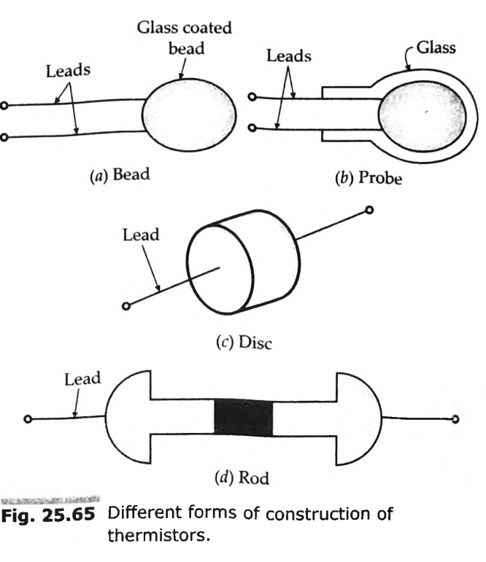
Construction of Thermistors
Thermistors are composed of sintered mixture of metallic oxides such as manganese, nickel, cobalt, copper, iron and uranium.
They are available in variety of sizes and shapes. The thermistors may be in the form of beads, rods and discs.
A thermistor in the form of a bead is smallest in size and the bead may have a diameter of 0.015 mm to 1.25 mm. Beads may be sealed in the tips of solid glass rods to form probes which may be easier to mount than the beads.
Glass probes have a diameter of about 2.5 mm and a length which varies from 6 mm to 50 mm.
Discs are made by pressing material under high pressure into cylindrical flat shapes with diameters ranging from 2.5 mm to 25 mm.

Slide 44
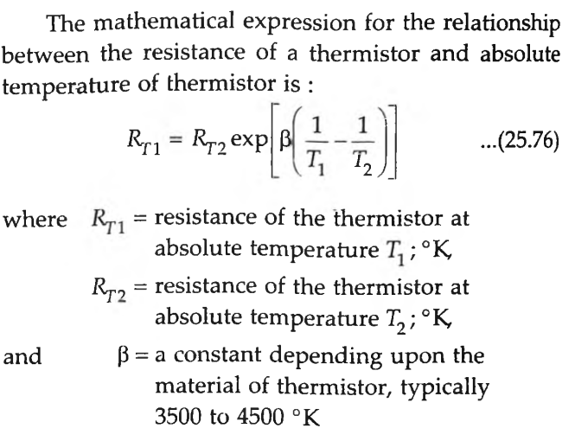
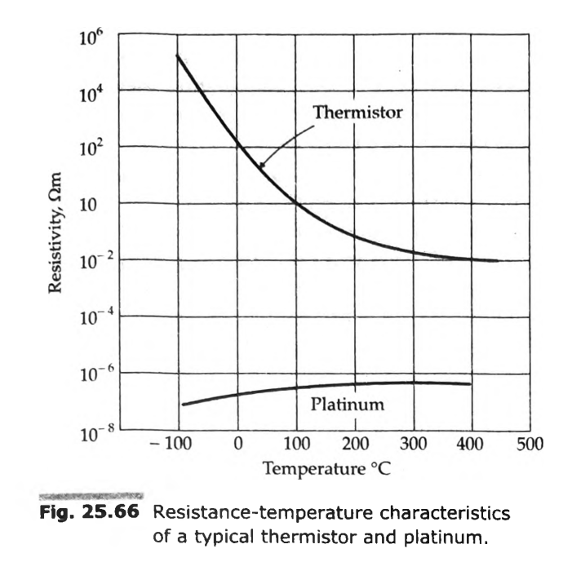
Resistance-Temperature Characteristics of Thermistors

Slide 45
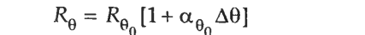
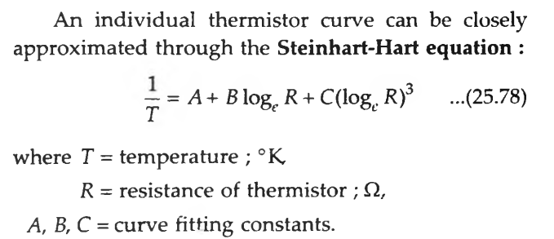
The characteristics of thermistors are no doubt non-linear
A thermistor exhibits a negative resistance temperature co-efficient which is typically about 0.05/°C.

Slide 46
Voltage-Current and Current-Time Characteristics of Thermistors
Three important characteristics of thermistor
make them extremely useful in measurement and
control applications. These are :
A the resistance-temperature characteristics.
A the voltage-current characteristics.
A the currcnt-tinie characteristics

Slide 47
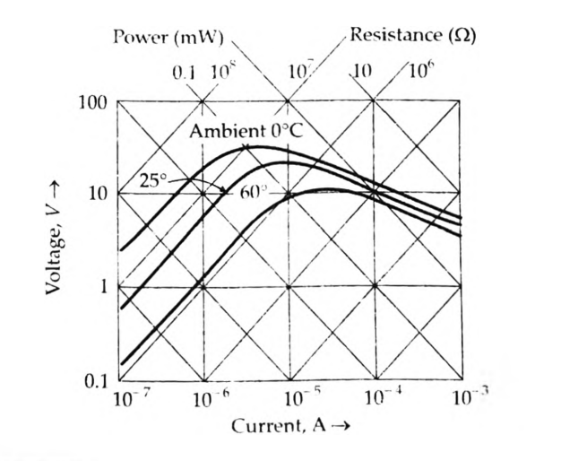
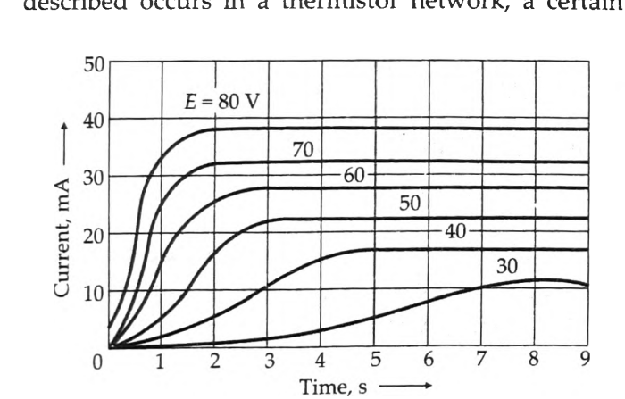
2. Voltage-Current Characteristics.
3. Current Time Characteristics

Slide 48
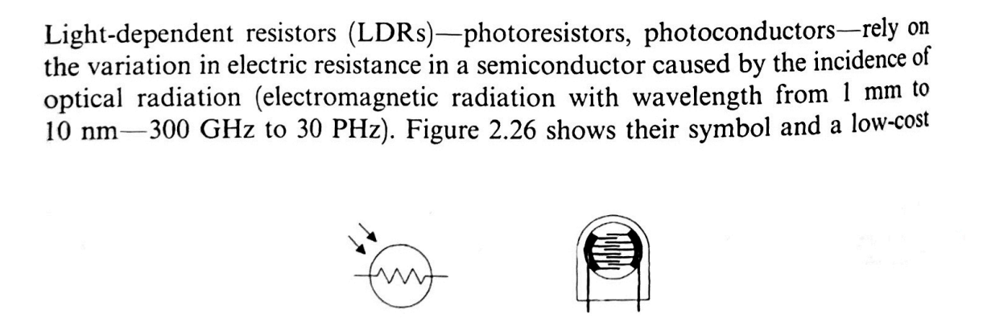
LIGHT DEPENDENT RESISTOR

Slide 49
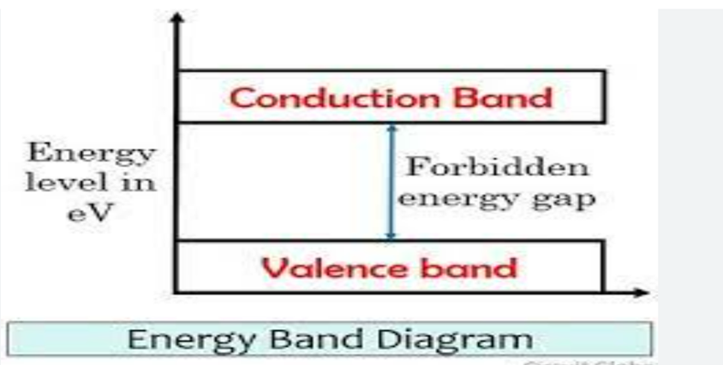
Valence Band
It is basically defined as the energy band that comprises of valence electrons present in the outermost shell of an atomic structure.
These valence electrons, when provided with sufficient energy, get changed into free electrons and moves to conduction band thereby causing conductivity.
Conduction Band
A conduction band is defined as that energy band that consists of free electrons that are responsible for conduction.
This band is present above the fermi energy level i.e., is at higher energy state.
Thus, electrons require a large amount of excitation energy to reach conduction band thereby giving rise to electric current.
It is abbreviated as CB and it allows free movement of electrons inside it.

Slide 50
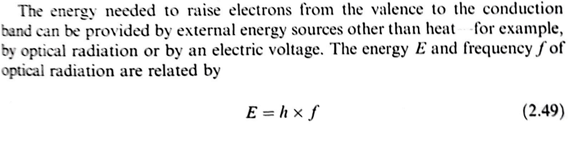
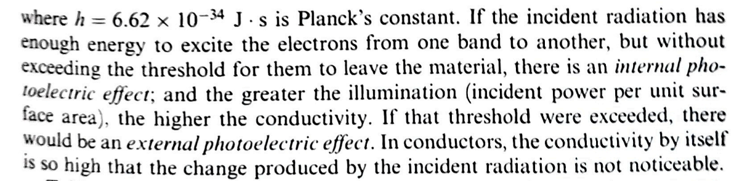

Slide 51
Working of LDR
LDR works on the principle of photoconductivity. According to photoconductivity the conductivity of a material is increased when the intensity of incident light is increased.
There are certain semiconductor materials that exhibit such property known as photoconductive material.
There is an energy band gap between the valance band and the conduction band of the semiconductor material.
The electrons residing in the valance band cannot participate in the conduction unless energy equal to the amount of the band gap energy is provided.
The incident light containing photons had enough energy to excite electrons into the conduction band. The number of electrons passing into the conduction band depends on the amount of light energy.
Since these electrons contribute to the current flow, the resistance of the material decreases. Therefore increasing the intensity of light increases the number of free electrons and decreases the resistance of the LDR.

Slide 52
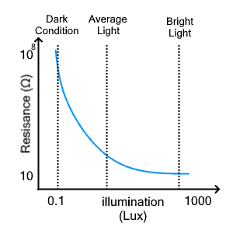
Illumination Characteristics
This is a graph between the resistance of the LDR and with change in the intensity of the incident light called illumination. As LDR is not linear, the relationship forms a curve as shown in the figure below. T
he x-axis represents illumination in lux while the y-axis represents the resistance of LDR in ohms.

